Slide 1
ZOMATO
A Case Study
- By Smeet Singh

Slide 2
Introduction
Zomato is a dynamic and competitive company with a very strong hold in the food tech industry. This project aims to provide actionable insights through data analysis to assist in strategic decisions for expanding restaurant operations globally. Zomato is a prominent player in the food tech industry, offering services like restaurant discovery, food delivery, and reviews. Understanding its business model and market reach is crucial for analyzing its data effectively.
Project Objective:
Develop a comprehensive dashboard and analysis to support strategic decisions for expanding restaurant operations.
Key Focus Areas:
Cleaning and organizing data for accurate insights.
Exploring trends in restaurant counts, voter ratings, pricing, and service availability.
Suggesting new restaurant locations based on competition and market trends.

Slide 3
Data Overview
The dataset contains restaurant data from various countries, including attributes like ratings, price range,cuisine type, and services (online delivery, table booking).
Key Metrics :
Ratings & Voters: Customer feedback and engagement.
Price Range: Average cost for meals.
Location: Countries and cities where restaurants are located.
Services: Availability of table booking and online delivery.

Slide 4
SELECTION OF COUNTRIES
We will try to find suitable countries to open our new Restaurant on the basis of :
Number of Restaurants already present in countries
Expenditure
Ratings of Restaurants

Slide 5
Countries and Count of Restaurants
Countries based on Count of Restaurants
Canada
Qatar
Singapore
Sri Lanka
Indonesia
Philippines
Australia
Turkey
New Zealand
Brazil
United Arab Emirates
South Africa
United Kingdom
According to this chart, it is clear that INDIA and USA has most number of Restaurants, so we will exclude these as higher number of restaurants will result in more competition

Slide 6
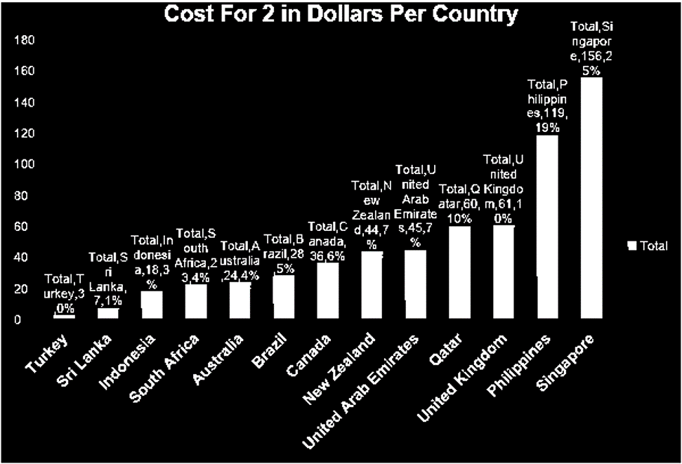
Expenditures In Different Countries
Remaining countries having less expenditure .
Turkey
Sri Lanka
Indonesia
South Africa
Australia
Brazil
According to above chart, we can see that from Canada to Singapore ,the Expenditure is quite high. So, keeping in mind the expenditure,countries were filtered.

Slide 7
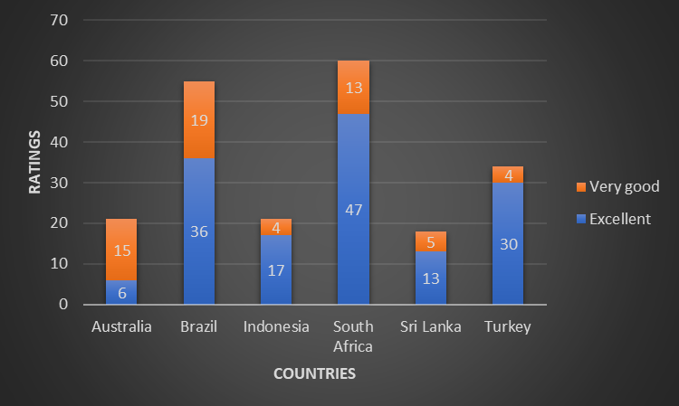
COUNTRY AND RATINGS
According to below chart, we can conclude:
South Africa, Brazil and Turkey have the most ratings in Excellent and Very Good Category. This means that people prefer eating in these countries and give better ratings to food

Slide 8
According to our analysis on Number Of Restaurants ,Expenditure and Rating Distribution across countries, we would be interested in below countries for further analysis
SOUTH AFRICA
BRAZIL
TURKEY

Slide 9

CITIES ANALYSIS
Now as we have selected our countries, its time to look for the cities
We will follow similar approach to drill down to find suitable cities to open new restaurant
We will compare the Count Of Restaurants and Ratings given by customers

Slide 10
COUNT OF RESTAURANTS AND RATINGS IN CITIES

Slide 11
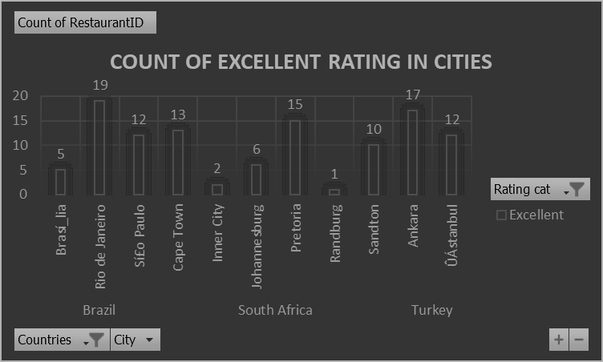
RATINGS OF RESTAURANTS IN CITIES

Slide 12
With the help of previous 2 charts we can conclude that
Cities with Highest Count of Restaurants : Sao Paulo , Rio de Janeiro , Brasilia ,Cape Town, Pretoria , Ankara
Cities with Lowest Count of Restaurants : Randburg, Inner City, Johannesburg
Now, looking at the ratings, Rio De Janeiro , Ankara , Pretoria, Cape Town stand out High.
So by considering these 2 factors, we can filter out below suitable cities for our expansion:
Rio De Janeiro
Ankara
Pretoria

Slide 13

DIVING DEEP
Now as we have selected our countries, we will start our further analysis on points like:
Cuisines serving in restaurants
Ratings distribution
Availability of Online Delivery
Availability of Online Table Booking

Slide 14

RATINGS
We have created the Ratings Bucket as per the table shown
So, the least Rating is BAD and the best Rating is EXCELLENT!
We will see how ratings are behaving according to the countries we have selected.
This will help us to see what type of reviews customers are giving in our countries
1-2 | BAD
2-3 | GOOD
3-4 | VERY GOOD
4-5 | EXCELLENT

Slide 15
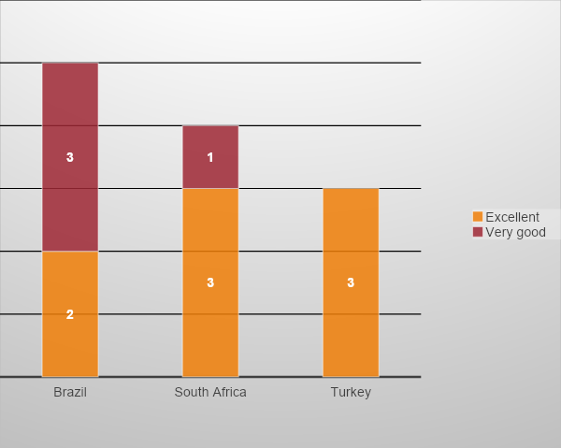
All 3 countries have most of the ratings under EXCELLENT category
They are also doing great under VERY GOOD category
There are few BAD ratings in BRAZIL only which we can neglect.

Slide 16

CUISINES
Cuisines are the most important factor need to be considered while opening a Restaurant
More the popular Cuisines, more it will attract Customers.
So, we will try to find out, which Cuisines are most popular in these countries.
We will determine this on the basis of counts of EXCELLENT ratings provided by customers

Slide 17
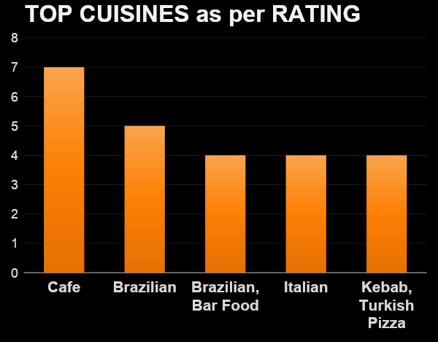
These are the Cuisines which have most Excellent ratings from customers in our preferred countries
We can start our restaurant with these 5 Cuisines.

Slide 18
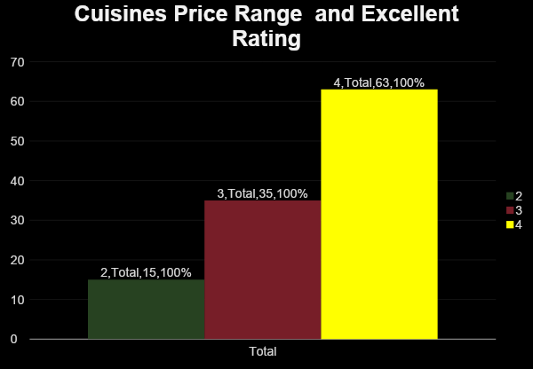
We have compared Excellent Rating with our Price Range Of Cuisines and found that most of the Excellent Ratings fall under Price Range of 3 and 4
This indicates that we can have Price Range High in our restaurants

Slide 19
ONLINE TABLE BOOKING
In this era of Online World, it is crucial to keep Online options available for the customers
Customers would be happier if they could book a table just by sitting at home.
Lets see the general trend of Online Table Booking in our selected countries.

Slide 20
According to the chart, we can see that most of the restaurants DO NOT provide the Online Table Booking option
So if we introduce this feature in our new restaurant ,then its more likely to attract more customers

Slide 21
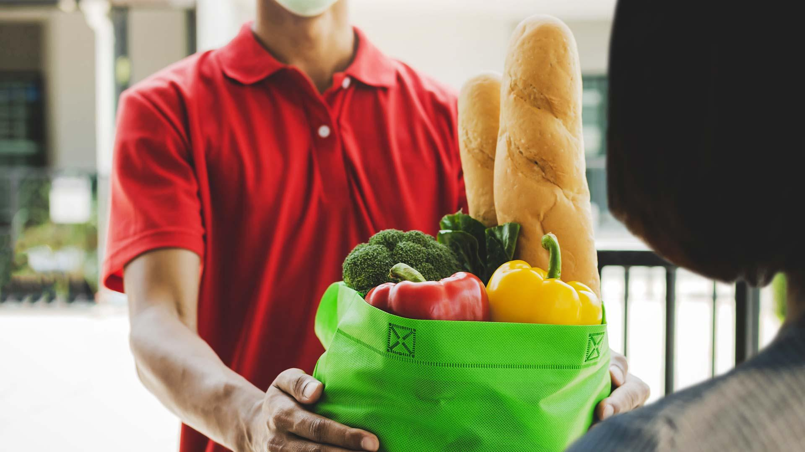
ONLINE DELIVERY
Online Delivery is also one of the major factors in increasing the revenue of a restaurant
Online Delivery helps restaurants to increase their reach and number of customers
We will see how much restaurants are providing this facility in our selected countries

Slide 22
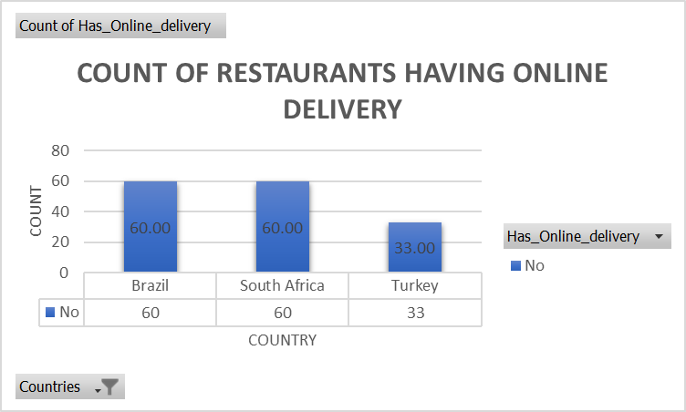
According to the chart, we can see that NONE of the restaurants provide Online Delivery
So, it would be really beneficial for our restaurant if we can provide Online Delivery facility in these countries.

Slide 23
RECOMMENDATIONS
Countries to be considered for opening new restaurants :
Cities to be considered for opening new restaurant in suggested countries
SOUTH
AFTRICA
BRAZIL
TURKEY
Rio De Janeiro
Ankara
Pretoria

Slide 24
RECOMMENDATIONS
We should provide Online Table Booking facility in our new restaurants
We should provide Online Delivery facility also
We can serve following cuisines in our new restaurant
Café
Brazilian
Brazilian bar food
We can go for the Higher Price Range as well for our Cuisines.

Slide 25
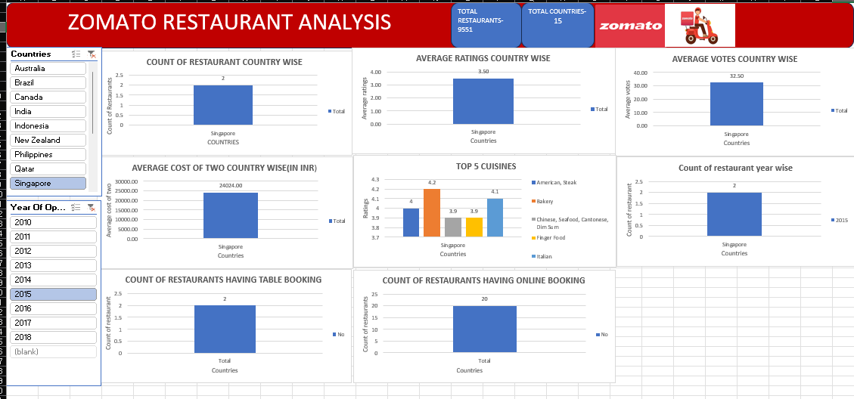

Slide 26
Thank you
Smeet Singh
NEWTON 2024 BATCH

